Slide 1
Paper Title : Cross-Domain Review Generation for Aspect-Based Sentiment Analysis
Jianfei Yu, Chenggong Gong, Rui Xia
Presented by: Team 12
Sazid Hasan Tonmoy (ID - 16301003)
Tasnim Sultana (ID - 19301173)
Abdulla Al-Amin (ID - 19301083)

Slide 2
Tables of Contents
 | Contents | Page Number
1 | Aspect Based Sentiment Analysis | 03
2 | Cross Domain Review Generation(CDRG) | 04
3 | Methodology | 05
4 | CDRG Model and Formula | 06
5 | Experiment | 07
6 | Experimental Results and Analysis | 08
7 | Conclusion and Future Works | 09

Slide 3
ABSA
Aspect-Based Sentiment Analysis (ABSA) is a text analysis technique that categorizes data by aspect and identifies the sentiment attributed to each one.
GOAL:
Extract the aspect terms mentioned in review sentences and predict the sentiments over them.
Existing paradigms of ABSA :
• feature-based adaptation
• instance-based adaptation
Shortcomings of Existing Models:
supervision signals for main task solely come from the labeled source domain
lack of interpretability

Slide 4
Cross-Domain Review Generation (CDRG)
Proposed a new domain adaptation paradigm called Cross-Domain Review Generation
Effective two-step approach :
1.Domain generalization step
2. Domain specification step
Proposed Training Strategy:
1. End-to-End ABSA (E2E-ABSA)
2. Aspect extraction (AE)
Main contributions:
• Propose a new domain adaptation paradigm
• With the help of generated target-domain reviews
• Sufficient annotated reviews generate many annotated target reviews for domain adaptation

Slide 5
Methodology
Cross-Domain Review Generation (CDRG): transform a labeled source review to a labeled target review by converting its source-specific attributes to target-specific attributes while retaining the remaining contents and its labels
Domain Generalization: convert each source-domain review to a domain independent review
Domain Specification: convert a domain-independent review to a target domain review
Pre-trained BERT model is re-trained with Masked Language Model(MLM)
Target-Domain MLM(TD-MLM)

Slide 6
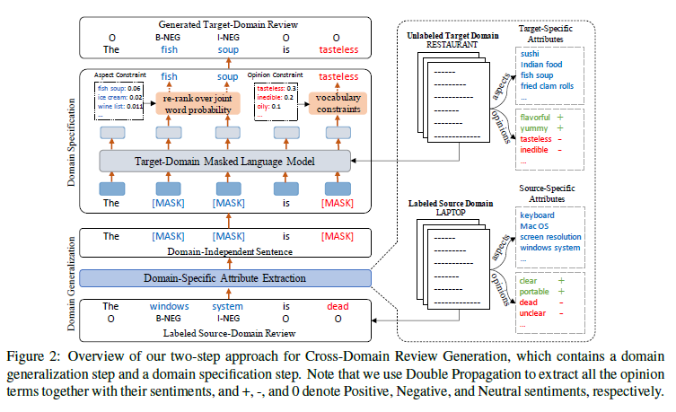


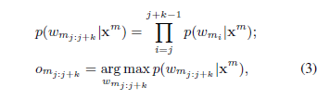
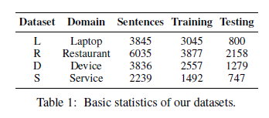
CDRG Model
Formula
Datasets

Slide 7
Experiment
Datasets: Four benchmark dataset Laptop(L), Restaurant(R), Device(D), Servic(S)
Settings: Ten transfer pair from each dataset domain
Compared Systems & Hyperparameters: Effectiveness of CDRG is compared to existing state-of-the art Models

Slide 8
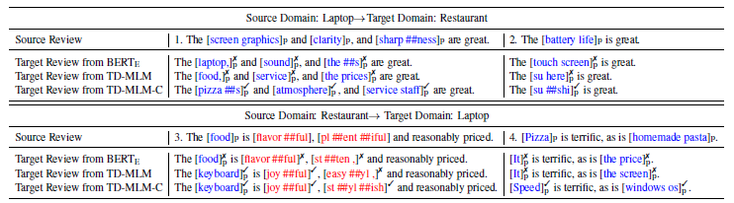
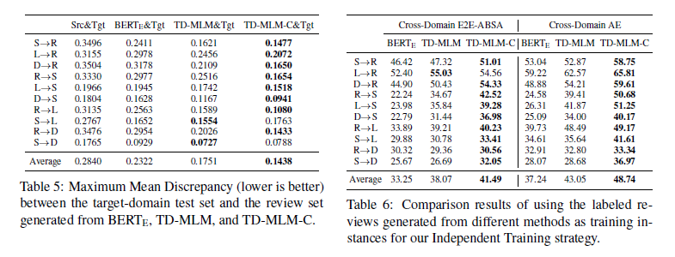
EXPERIMENTAL RESULTS AND ANALYSIS:

Slide 9
Conclusion
CDRG-based algorithms for cross-domain E2E-ABSA and cross-domain AE tasks perform much better than existing state-of-the art methods, according to experiments on four benchmark datasets.
Future works
Adversarial training needs to be stabilized
Dependency on linguistic resources needs to be minimized

